Slide 1
Osnovna škola Bartola Kašića Vinkovci Erasmus + project 2016-2018 Young Enterprising Europeans
Active listening
March 2017 Marija Potiha

Slide 2
Rules
We listen to each other
We encourage each other
We respect principes of
tolerance
freedom
equality
discretion

Slide 3
Panto Pleticosa
In the waiting room of helth center in Copacabana are sitting 18 people. On the door in front of which sit the most people, says dr. Panto Pleticosa, shrink, nurse Jane July. In the waiting room there are general in civillian clothes, man with black shoes, three years old child, woman with curlers in her hair and a man with big nose. Suddenly a sound of fast steps is heard down the hall - beautiful red hair woman and chubby and somber man are entering the waiting room. They are entering ordination without knocking. At one moment, general coughted loudly, woman with curlers in her hair taught she heard a gun shoot, red hair woman furiously exited ordination, after her run dr. Pleticosa holding his head. Three year old child started crying.

Slide 4
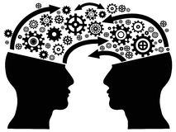
Communication is....
exchanging messages (verbal or non verbal) between two or more persons with an aim or purpose
irretriveable and unrepeatable – what’s been said can’t be withdrawn
unavoidable – it’s immposible not to communicate

Slide 5
SKILLS NEEDED FOR SUCCESSFUL COMMUNICATION
Active listening
Assertive talk i
Cooperation
Problem sloving
Conflict resolution

Slide 6
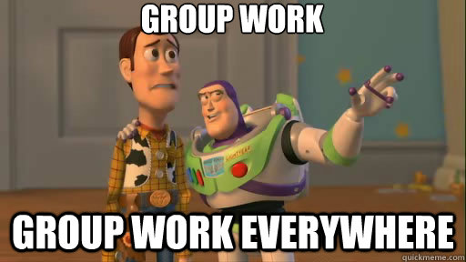
one who listens
one who talks
one who watches

Slide 7
NOT LISTENING
pseudolistening (Yes, yes. I'm listening to you.. – says man to a woman while watching footbal match.)
single layer listening (I'm fine. – says girl while crying.)
selective listening (Yes, yes, yes. I don't wanna hear about your trip experience, rather tell me about the flight – does it take long to get there? )
selective rejection (I heard you've got an A and a B, but I don't wann talk about that right now. You mentioned an F? Which subject?)
grabbing words
defensive listening
listening in ambush

Slide 8
WHAT TO DO WHEN INTERLOCUTOR SHOWS SIGNS OF NOT LISTENING
►pseudolistening ► change the topic
► grabbing words ► unagressively ask him/her to stop doing that
► single layer listening►direct question
►listening in ambush►deal with problem which has occour somewhere in the past

Slide 9
REASONS FOR NOT LISTENING:
• rhythm of speaking (voice) slower than rhythm of listening
• if listener thinks it’s not importat
• too much information

Slide 10
LISTENING ISN’T
▼
►silence
►thinking about what I’m going to ask or answer
LISTENING IS
▼
► actively trying to understand what’s been said

Slide 11
ACTIVE LISTENING
► communication skill
► includes understanding (emphaty),
► interpretation and remembering what’s been heard

Slide 12
Techniques of active listening

Slide 13
ask questions When? Who? Where? How? How much/many?
avoid Why? because it sounds aggressive

Slide 14
Encouraging
to encourage person who talks to experss his/hers opinion
Can you tell me more about the topic?

Slide 15
Emphaty
to show person who speaks that you understand him/her
I can see this situation is very demanding for you.
I'm happy for you.

Slide 16
Mirroring
to show understanding for interlocutors feelings, help him/her to estimate his/hers own feelings
You look tired.
You seem mad.

Slide 17
Summarize
to group relevant facts and ideas
So, this are main ides that you said.

Slide 18
Remaking
confirms the content of message so that needs, feelings and values hidden in the message are recognized, to express yourself pozitively and definetly

Slide 19
examples
I won’t let her go out at night. She is to young to know what’s best for her!
So, you worry about your daughters wellbeing.
You’re doing it wrong.
You know easier way? I would like to learn it.
I don’t want to work with him. Last time he ruined our project.
I see. You are concerned about success of your future project.

Slide 20
Discussion:
How much do you talk like this in your everyday life?

Slide 21
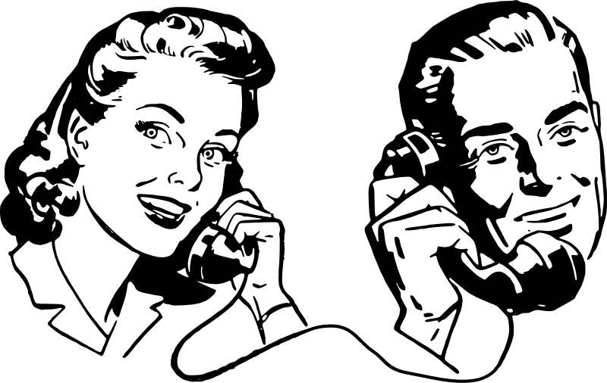
RULES OF ACTIVE LISTENING

Slide 22
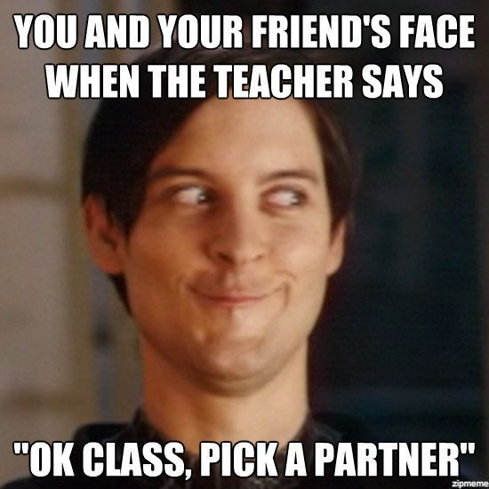

Slide 23
Instead of conclusion
God gave us one mouth and two ears so we could
listen more, and talk less.

Slide 24
evaluation

Slide 25
Literature
Bognar, L. (1999). Metodika odgoja. Sveučilište J. J. Strossmayera u Osijeku. Osijek.
Bognar, L., Ništ, M., Tonković, Lj. (2004). Miroljupci. Edukacijska kuća – Centar za mir, nenasilje i ljudska prava. Osijek.
Brdar, I. (1993). Što je socijalna kompetencija?. Godišnjak Zavoda za psihologiju, Rijeka, str. 13-19.
Kolesarić, J .Matošina Borbaš, S.,Prister Švarc, V. (2014). EduKa, priručnik za mlade o toleranciji i nenasilju. S.O.S. Virovitica.
Marušić, S., Pavletić, Z., Ptiček, R. Razvoj komunikacijskih vještina.

