Slide 1
Szkoła Podstawowa nr 2 im. Tadeusza Kościuszki w Łęcznej Erasmus+ Project ’Young Enterprising Europeans’ 2016 - 2018 Our School Mini - Company

Slide 2
As a part of the Erasmus+ project that is being implemented in our school we, like all our partners, established our school mini – company at the end of the previous year.

Slide 3
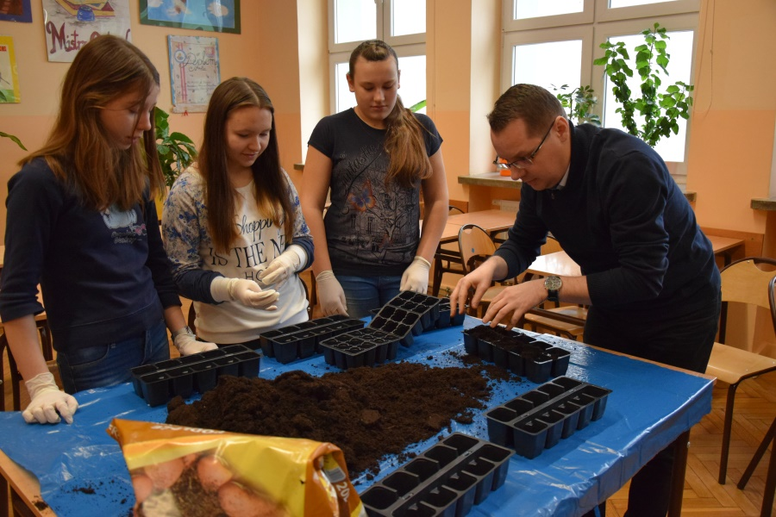
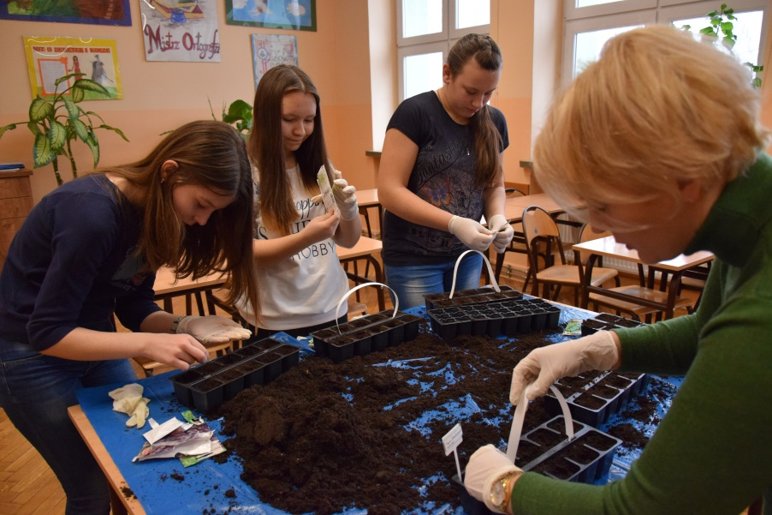
Students who are involved in the project, under the guidance of the teachers, have an opportunity to manage a small business. They sowed different kinds of herbs, for instance basil, mint, thyme, cumin and oregano.

Slide 4
They are taking care of them and later …

Slide 5
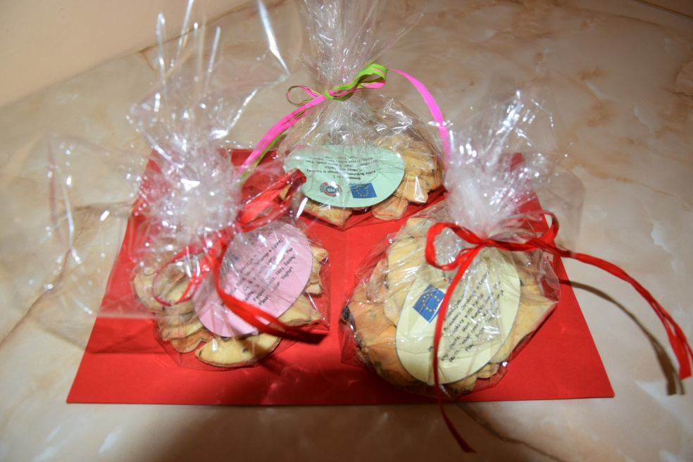
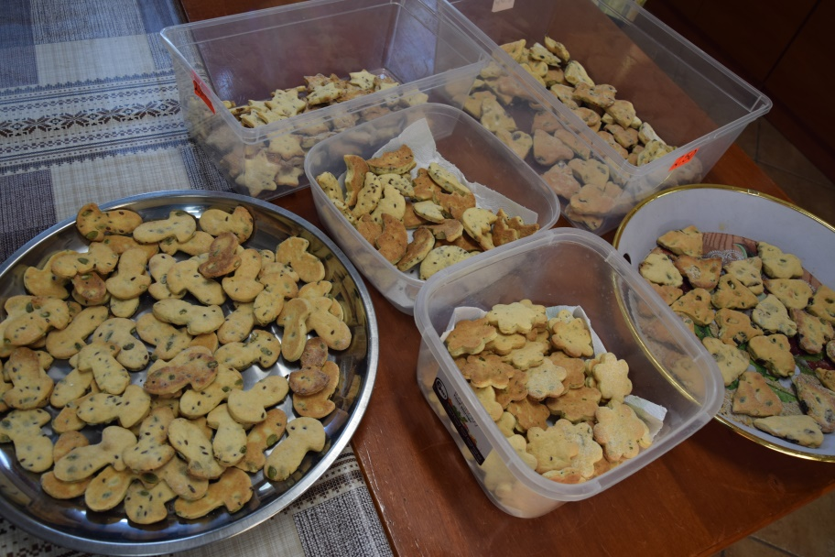
when the herbs grow enough they prepare various snacks with them.

Slide 6
Every business should have the name to be recognizable and unique. We also decided to call our school company. The ideas were really creative and by means of brainstorming we decided to call it Healthy 1. Its name refers to the name of our school. It was the first school in our hometown and healthy because it produces only healthy handmade products.

Slide 7
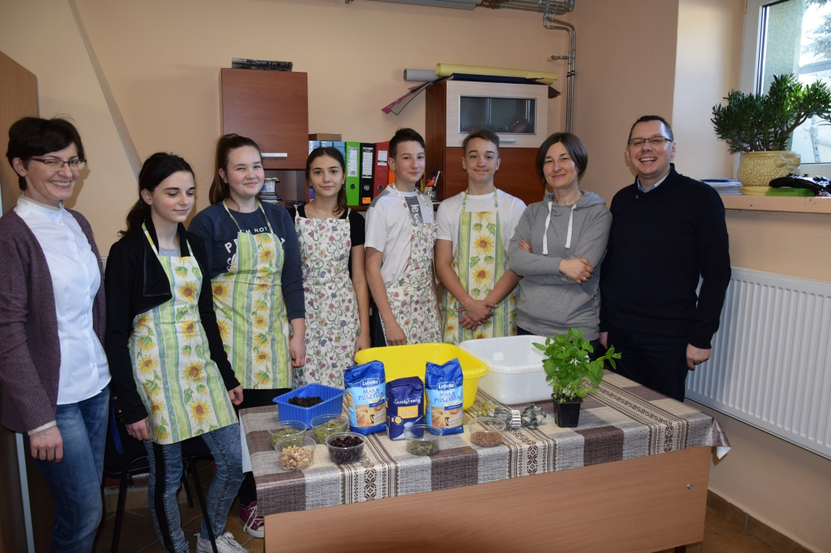
The mini - company is cooperating with the school cooking club and before the visit in Sicily, our first project mobility, we baked cookies with herbs.

Slide 8
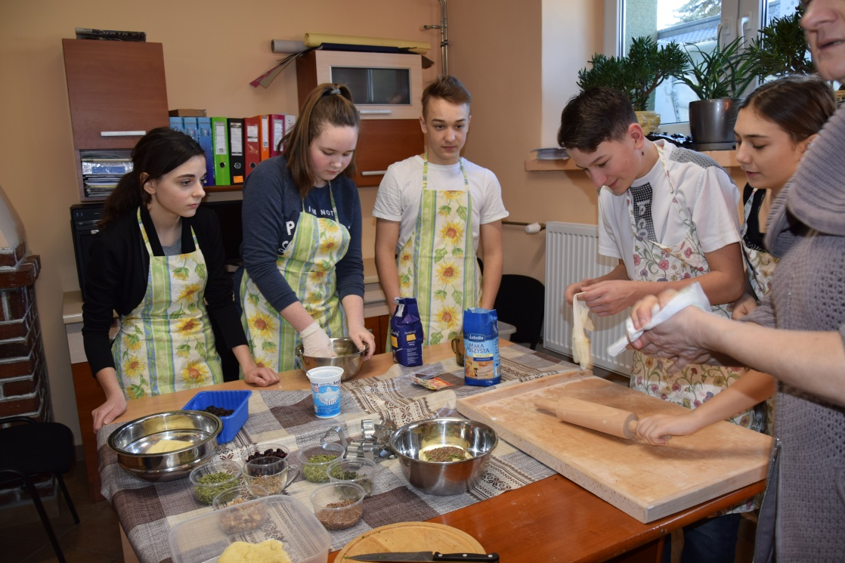

Slide 9
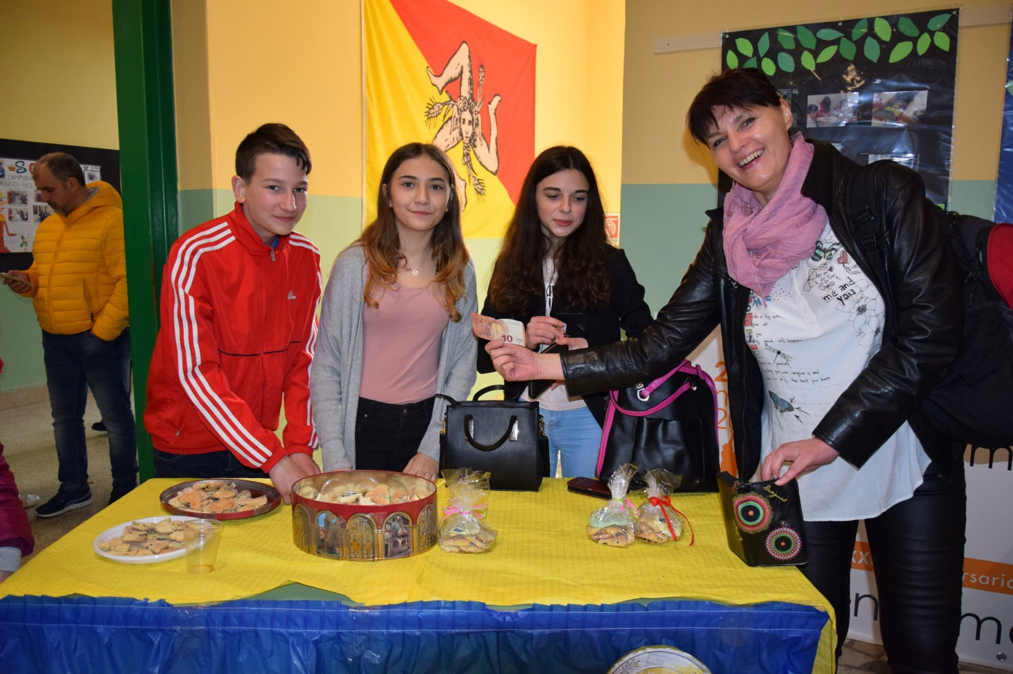
We packed them and brought to our partner school to earn our first money.

Slide 10
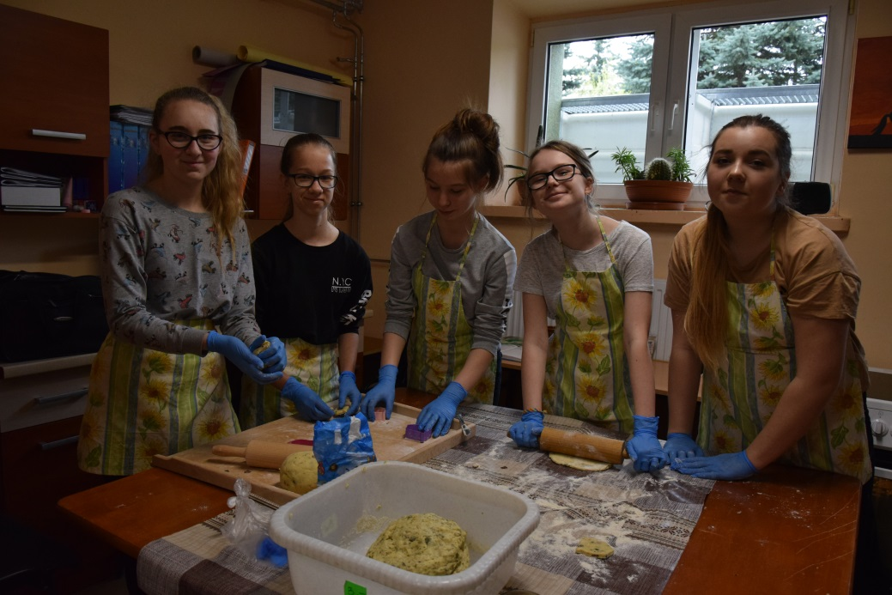
Before coming to Croatia we had also baked our delicious healthy cookies.

Slide 11
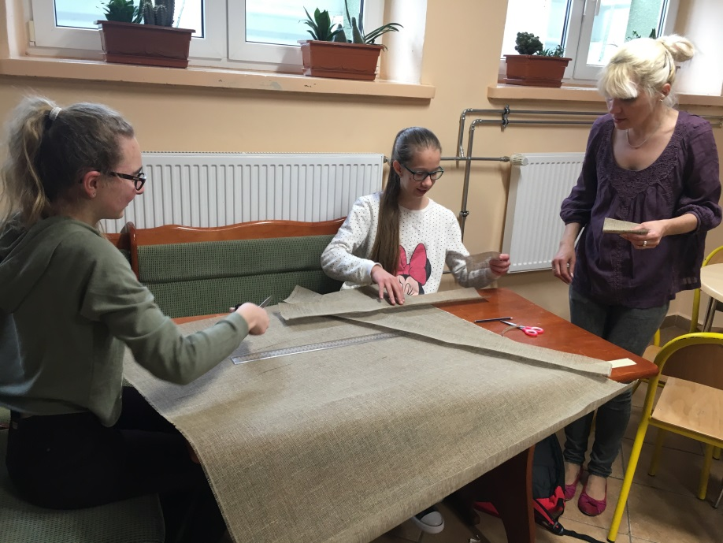
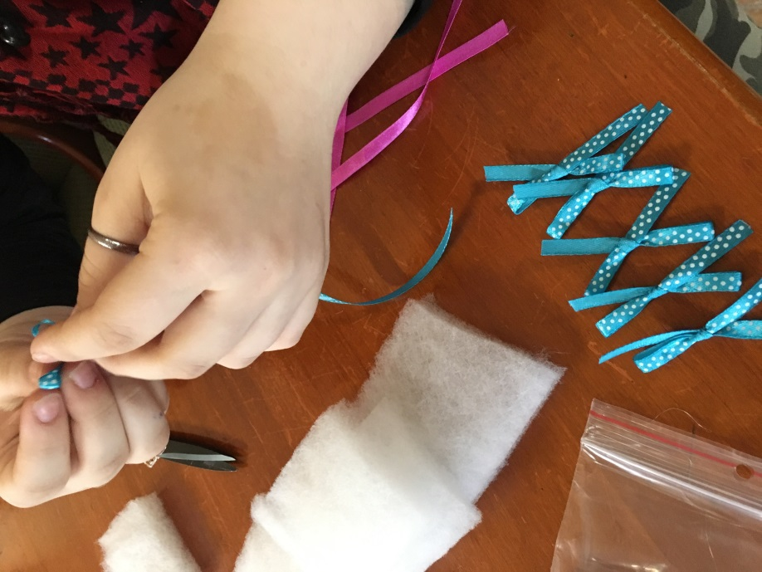
Our school business is still developing. Now, we are also cooperating with the school handicraft club and producing more products: pincushions, bookmarks and scented sachets for wardrobe.

Slide 12
Why entrepreneurship? We do not have entrepreneurship as a seperate subject at school at lower secondary school level in Poland. However, we believe that gaining knowledge in this field by our students will be very crucial when they face a job market. That is whythe aims of the mini - company are: - developing planning skills, - gaining entrepreneurial experience, - learning how to work to deadlines, - acquiring abilities of working in a team, - evolving students’ creativity.

Slide 13
The aim of the mini company is also to map the realities of the market - students run the business and make business decisions.The essence of running such a school company is to teach students thinking in terms of entrepreneurship, collaboration and investing.

Slide 14
Students also acquire organisational skills. They learn to split functions between themselves within the company. Students involved in running this company acquire excellent communication skills exhibited in contact with customers.

Slide 15
In addition, students learn empathy and sensitivity to other people engaging in charity. Like the wealthiest man in history, John Davison Rockefeller, we also donate money to charities, for instance, the Red Cross. Students are aware that a company engaging in social activities may be able to gain customers' trust and confidence, which in turn may be beneficial with higher sales.

Slide 16
The products created by our companies are pretty useful and the cookies are very healthy, dietary and tasty.

Slide 17
Thank you!

