Slide 1
THE FIRST STEP IN ENTREPRENEURSHIP
Developing innovative ideas for new companies

Slide 2
Entrepreneurs are individuals who see a need for a service or product and start a business to fill that need.

Slide 3
One of the steps they firstly make is to find a good, an innovative idea.

Slide 4
Let’s see some cases of successful Greek entrepreneurs. What inspired them to start a new company?

Slide 5
IDEAS BASED ON TECHNOLOGY

Slide 6
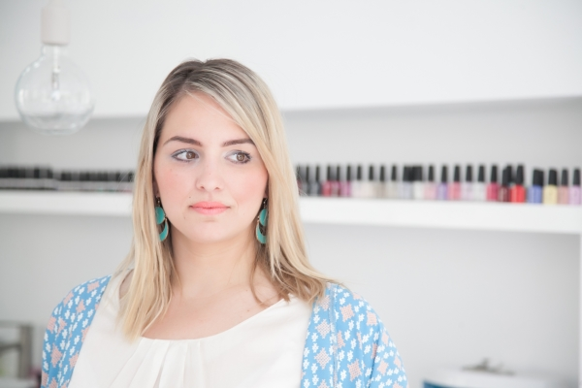
Alexia Kotsi Co-founder of Funkmartini

Slide 7
What is Funkmartini?
Funkmartini is an innovative online guide for beauty and wellness. It is the first complete online platform that brings together the best hair salons, nail bars and beauty centers in our city.

Slide 8
Thanks to Funkmartini, you can go to your nearest hair salon, the best aesthetician in the area or simply enjoy a relaxing massage in a SPA by experts.

Slide 9
The idea
It was an afternoon in Alexia’s office when the idea came to her. As she was working outdoors, if she wanted to call the hair salon, she needed to talk silently so as not to be heard. Then she thought that since we do everything online, why don’t we do this too?

Slide 10
With this in mind, she and her husband begun the development of the platform that today both costumers and hair salons love so much.

Slide 11
EVA EPITROPAKI VERA PAPAGGELOPOULOU JAMJAR

Slide 12
WHAT IS JAMJAR?
Jamjar is an exciting and dynamic platform for buying and selling handmade items. With more than 200 stores and 5,500 thousand selected handmade creations, Jamjar is the first and largest online market dedicated to the best Greek handmade products.

Slide 13
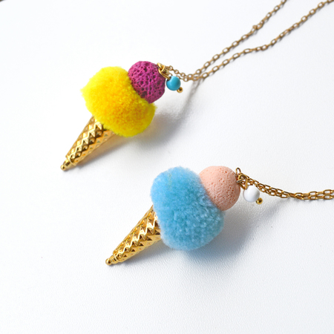
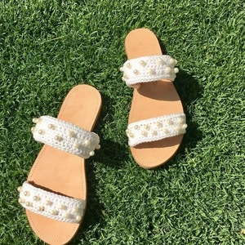
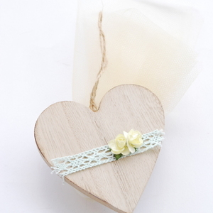
THE IDEA
Building an online wonderland we succeed that:
every visitor can discover the hand-crafted treasures of the most charismatic Greek craftsmen
help the most talented Greek creators to make their dream come true
re-recommend the modern Greek handmade product by releasing it from shackles of the past

Slide 14
The modern Greek handmade product is original, elaborate, aesthetically pleasing, accessible and as exciting as the story that "hides" behind it. Along with our online activity, we organize our jamjar.bazaar.

Slide 15
Athena-Pollina Dova Electronic games for employee assessment

Slide 16
What is Owiwi?
It is a ‘serious game’ that helps companies
find the right workers
evaluate and train the existing ones.
This online game
is an interactive, educational and enjoyable process
helps companies make the closest match between a job and the right candidate based on their personality.

Slide 17
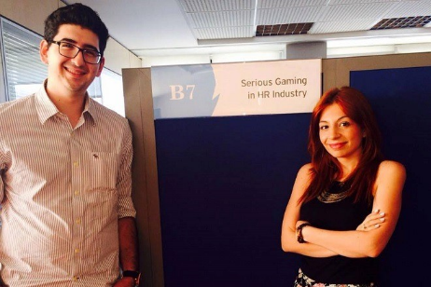
The idea
The idea for Owiwi had started when Athena was doing postgraduate studies. There, she met Elias Bartholomew, the co-founder of Owiwi.
At the very beginning, they had very bad relations, because Athena couldn’t cooperate with Elias for a university task. She wanted to work but he preferred to play electronic games…

Slide 18
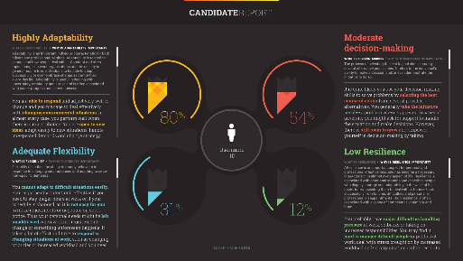
So, she came in her mind the idea for the game as a tool of assessment.
She also noticed that Millennials generation was very confused and with very few opportunities. By 2020 there would be 80% of human resources in the world and they couldn't evaluate them with the things I've been evaluating for 20 years now.

Slide 19
ENTERPRISING IDEAS BASED ON LOCAL PRODUCTS

Slide 20
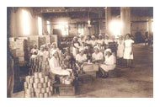
BALDJIS COMPANY
It is one of the oldest and most experienced canneries in Greece, indeed in the whole Balkans area.

Slide 21
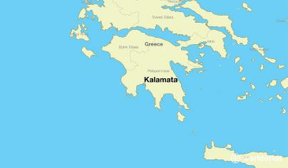
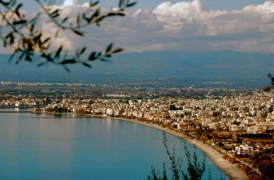
Established in 1910 by Menelaos Baldjis, the factory has been exporting the best products that Kalamata region has to offer.
Dried figs were one of the first products that were exported by this country, to the USA, and to other parts of the world.

Slide 22
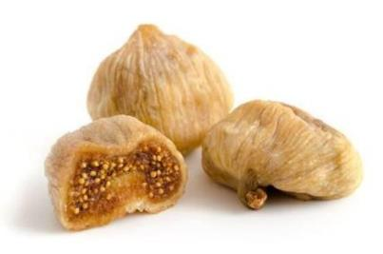
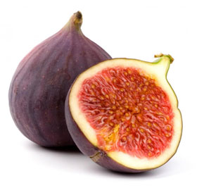
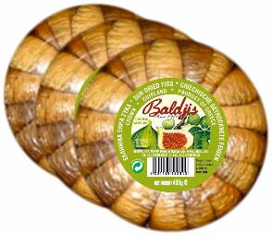
BALDJIS DRIED FIGS
Dried figs are low in fat and very low in sodium.
They contain no saturated fat or cholesterol.
They are a good source of fiber.

Slide 23
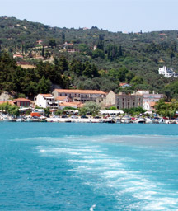
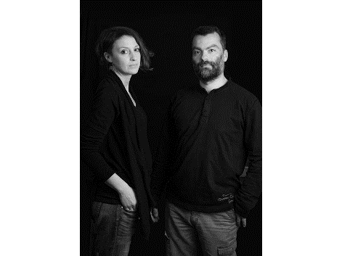
ASKADA FARM
A couple from Kymi decided in 2013 to create its own organic fig farm, fulfilling one of their childhood dreams.

Slide 24
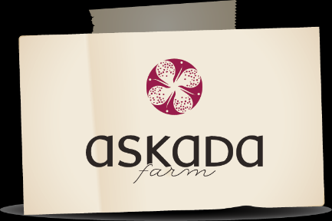
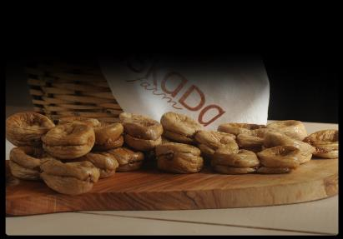
ASKADA FARM’S PRODUCTS
Their products exist in the shelves of well-known stores
all over the world.
Since 2014, the company receives an award from
Great Taste Awards.

Slide 25
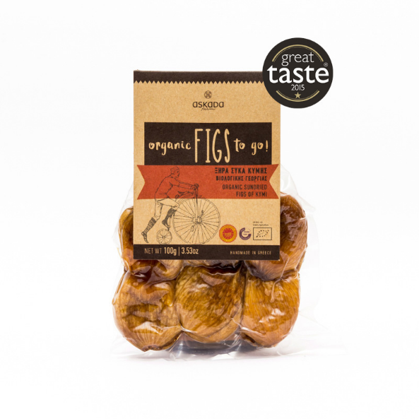
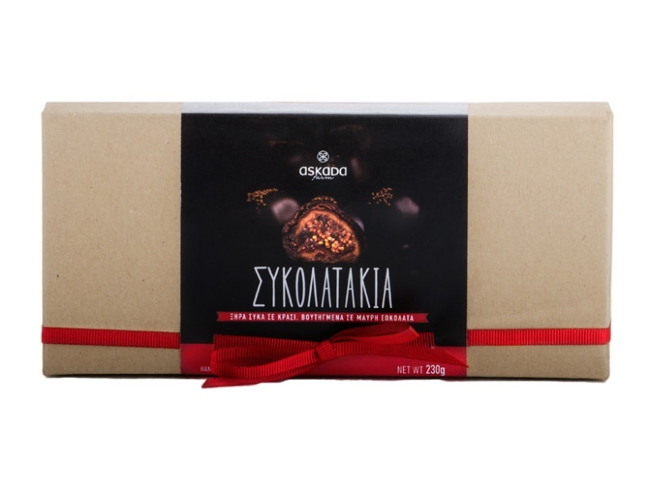
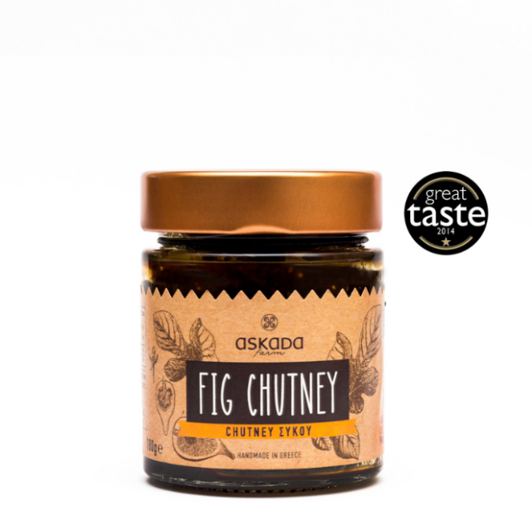
Fig chocolates with wine
Sundried figs
Fig chutney
Organic cacao fig bar

Slide 26
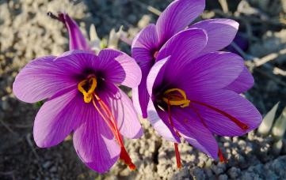
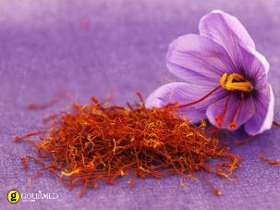
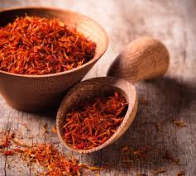
KROKOS KOZANIS (organic Greek red saffron)
The nature’s most precious plant, the saffron flower, else known as the Krokos flower. Growing in Kozani, North Greece, and giving its name to the land where it comes from, the Krokos village. A unique flower with a beautiful story to tell.

Slide 27
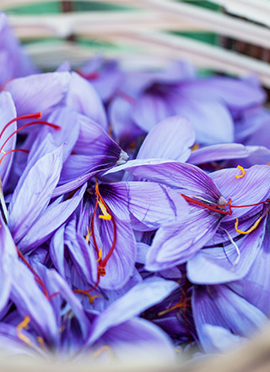
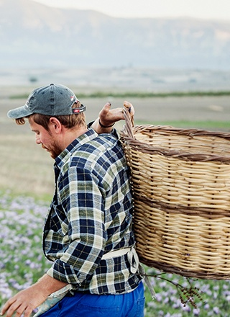
THE PRODUCTION
Krokos blossoms only once a year, every October, for barely two weeks, creating a purple magic carpet as far as the eye can see.
The flowers are harvested daily, and saffron antioxidants are at their peak.
After all the flowers have been collected, the fields look empty, but by dawn, the Krokos blooms once again, blanketing the fields in beautiful purple flowers.

Slide 28
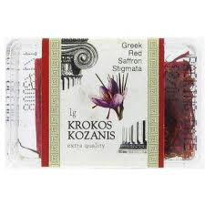
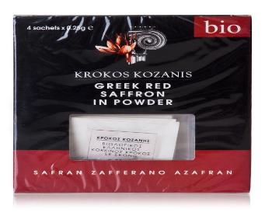
USES OF KROKOS KOZANIS
It is a precious spice and the best saffron quality in the world, that has significant antioxidant properties:
contributing to good health, well-being,
enhances the taste
lends its appealing color to many dishes, desserts and beverages.

Slide 29
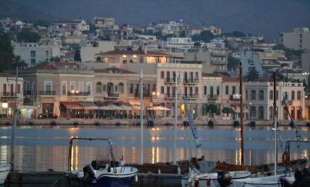
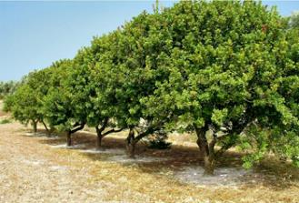
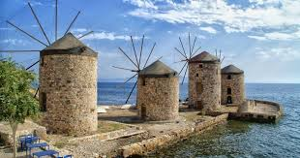
MASTIC OF CHIOS
Chios is situated in the Aegean Sea and it is notable for its exports of mastic gum and its nickname is the Mastic Island.

Slide 30
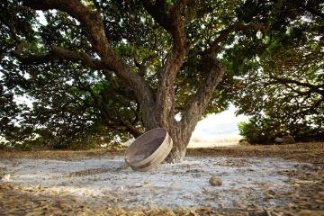
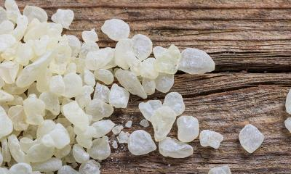
MASTIC OF CHIOS
Mastic is a resin obtained from the mastic tree.
It is known as the "tears of Chios," being traditionally produced on that Greek island, and, like other natural resins, is produced in "tears" or droplets.

Slide 31
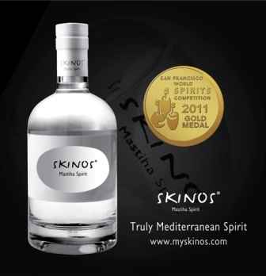
BYPRODUCTS OF MASTIC
Mastic is used in:
chewing gum; hence, the name
ice cream
vegetable preserves
jams
soups
drinks, such the liqueur called Skinos Mastiha Spirit.

