Slide 1
Osnovna škola Bartola Kašića Vinkovci Erasmus+ project 2016-2018 Young Enterprising Europeans
Visit to “Spačva”
November 2017

Slide 2
A group of 13 pupils and 2 teachers visited “Spačva”, which is the leading factory of the timber industry in the region, well known for high quality products made of oak wood. The factory uses wood from forests of common oak (Quercus robur). Every tree processed in the factory is between 100 and 120 years old. “Spačva” was founded in 1956 by merging of existing plants. It employs 850 workers. We were shown around the factory by Mr. Anđelko Dobročinac.

Slide 3
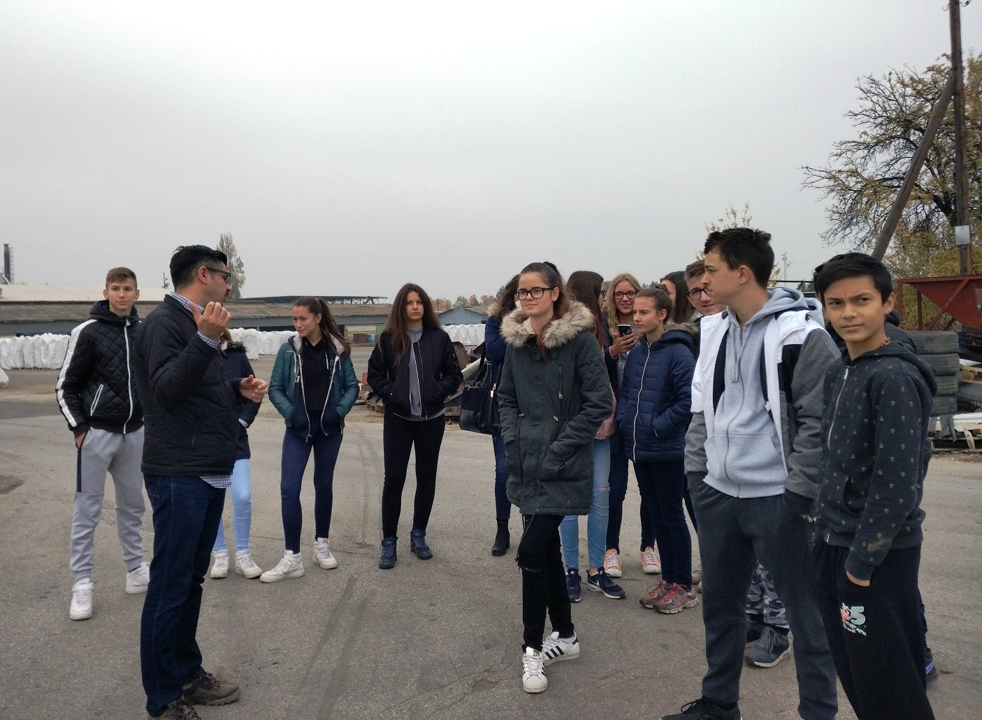

Slide 4
“Spačva” consists of 5 factories: - sawmill - parquet production
- final products factory - veneer factory - bio-fuels factory Final products are doors. About 90% of doors, veneer and parquet is exported to the countries of the European Union, mostly to France, Germany, Poland and Italy. Bio-fuels are wooden pellets and wooden briquettes and about 50% is exported.

Slide 5
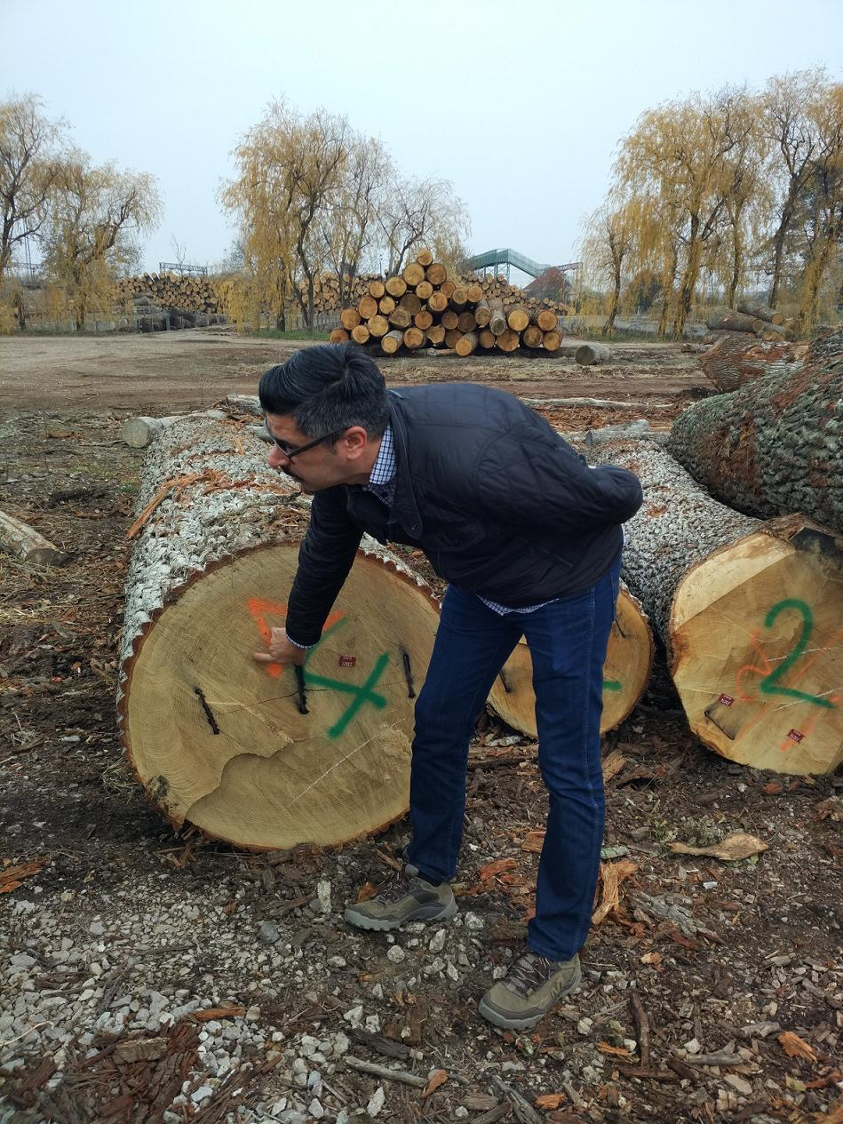
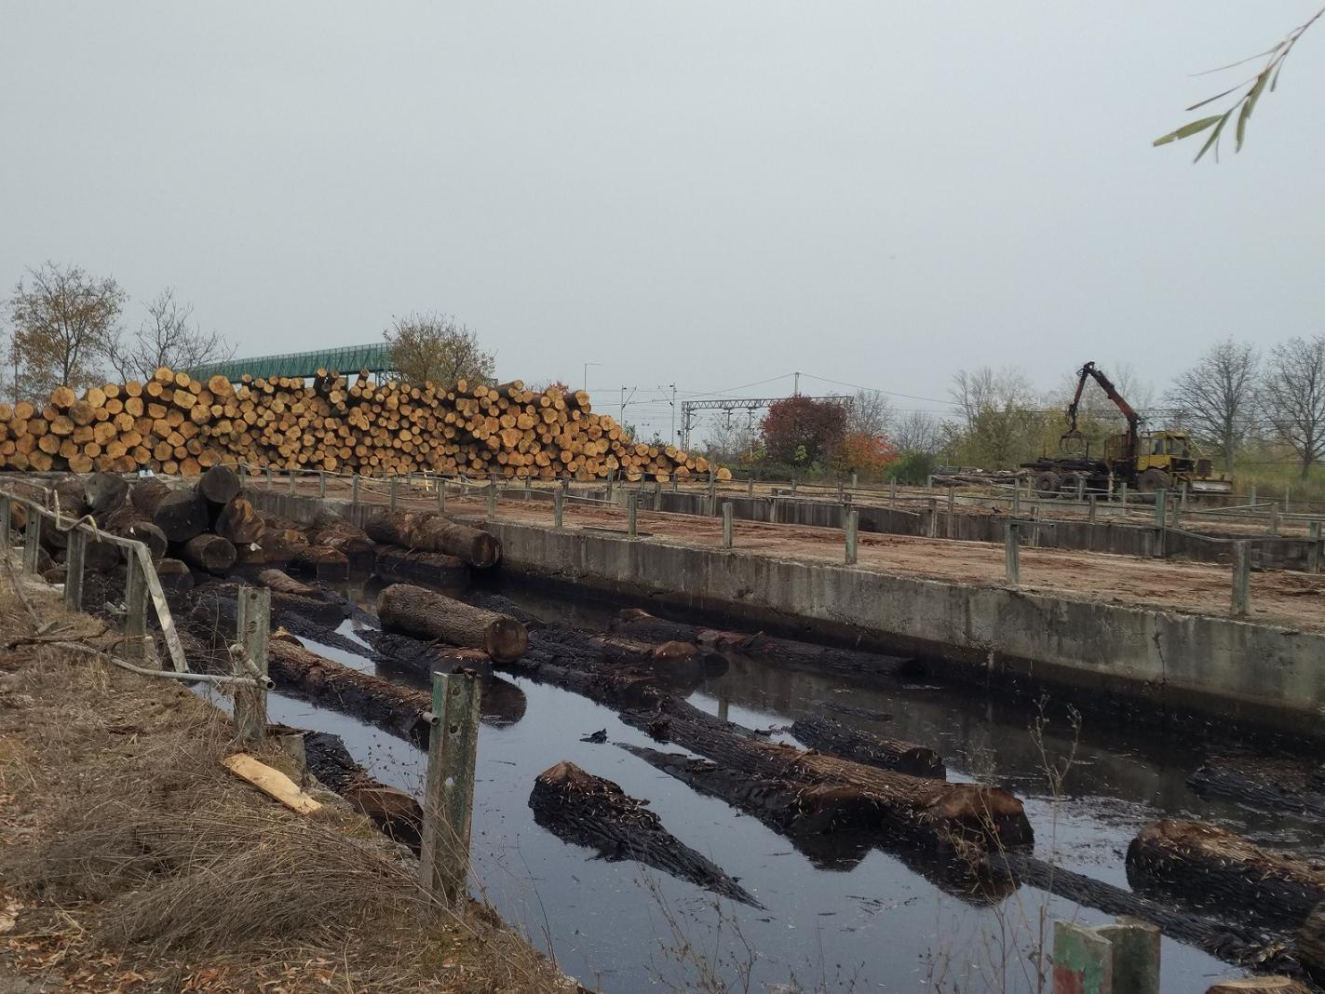
To protect wood from pests, logs are kept in water.

Slide 6
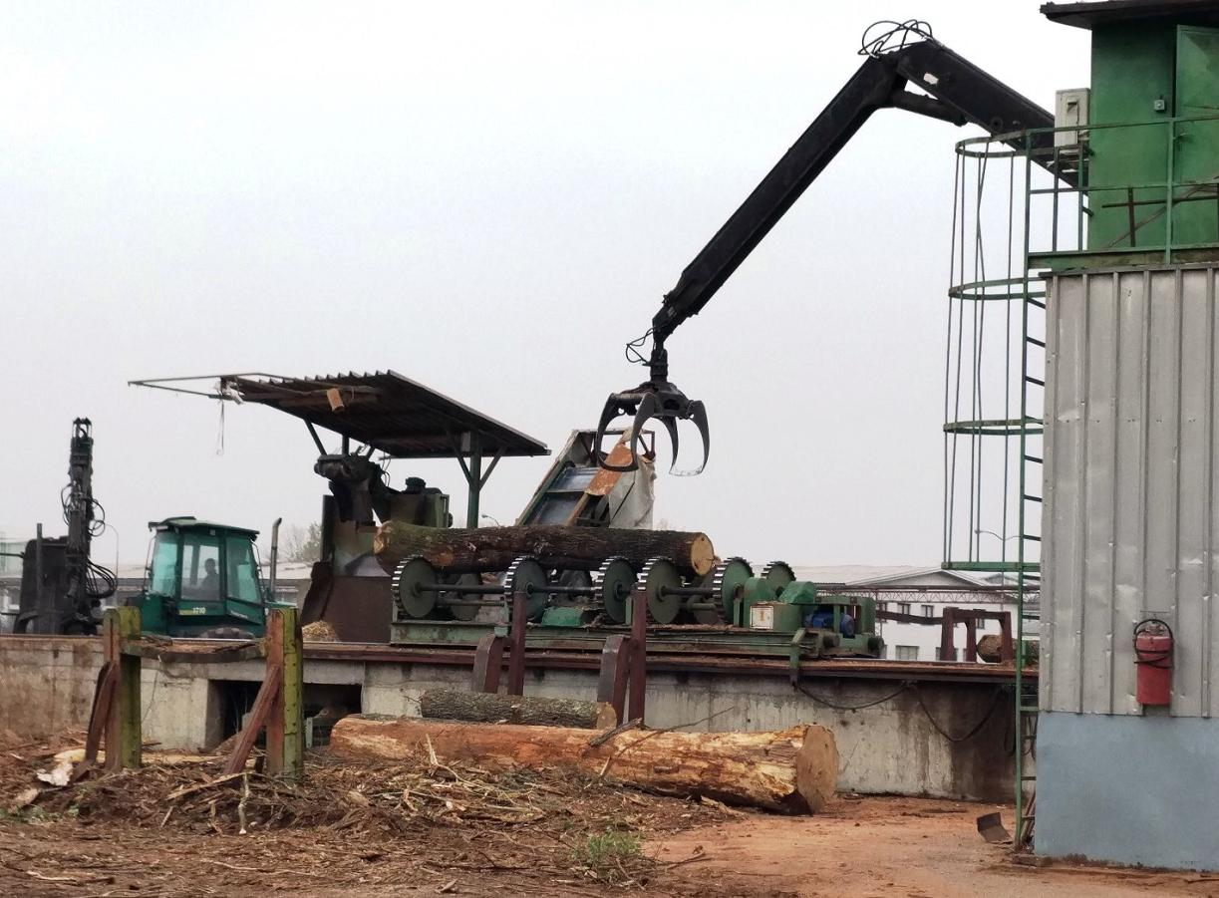
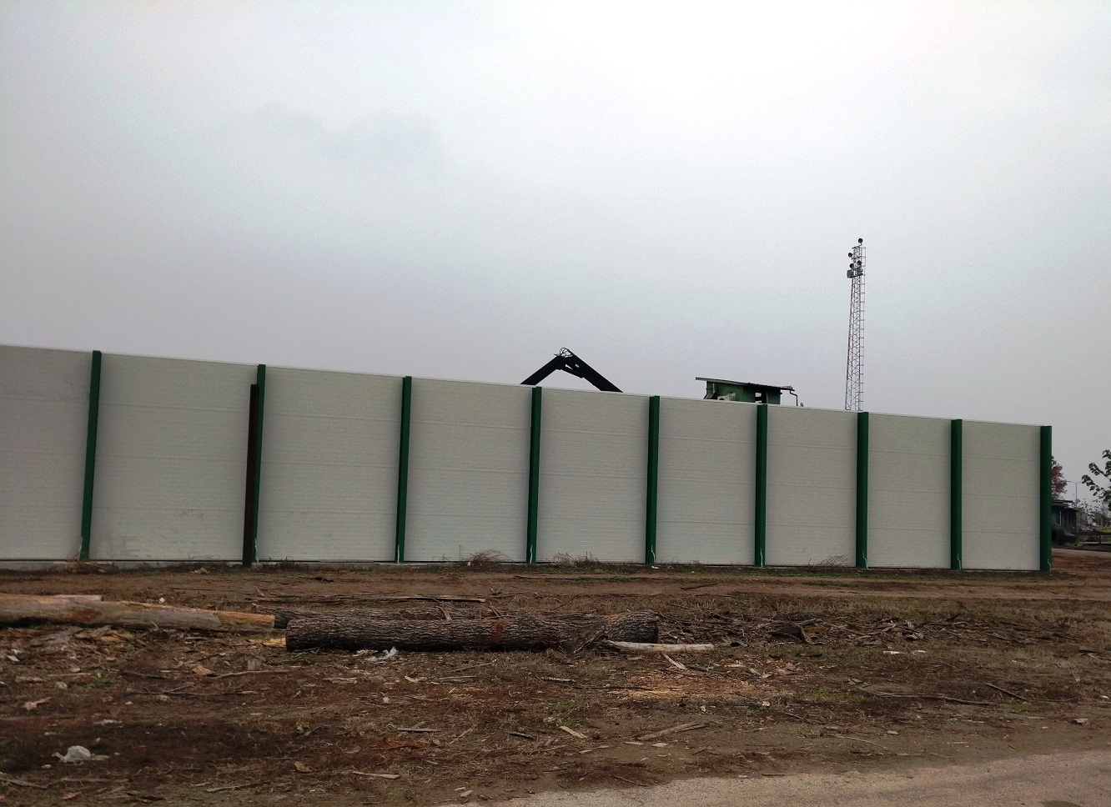
In order to protect people who live near the factory and reduce noise, “Spačva” bulit noise barrier.

Slide 7
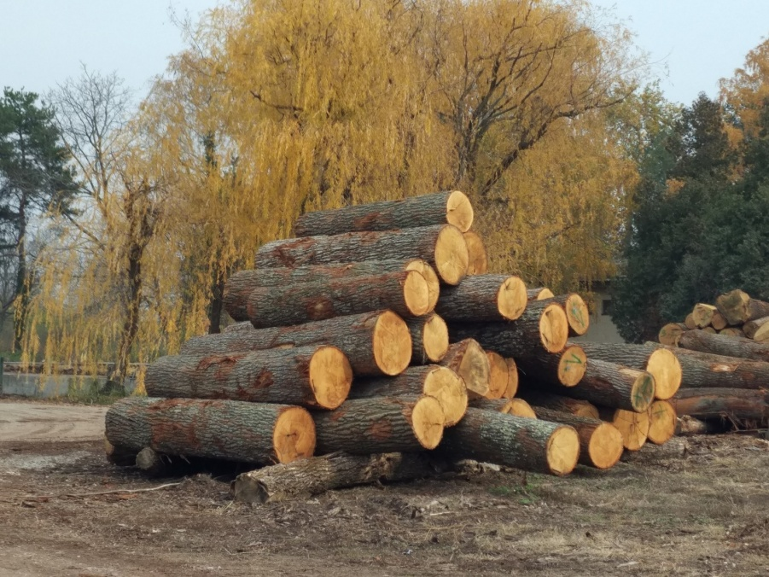
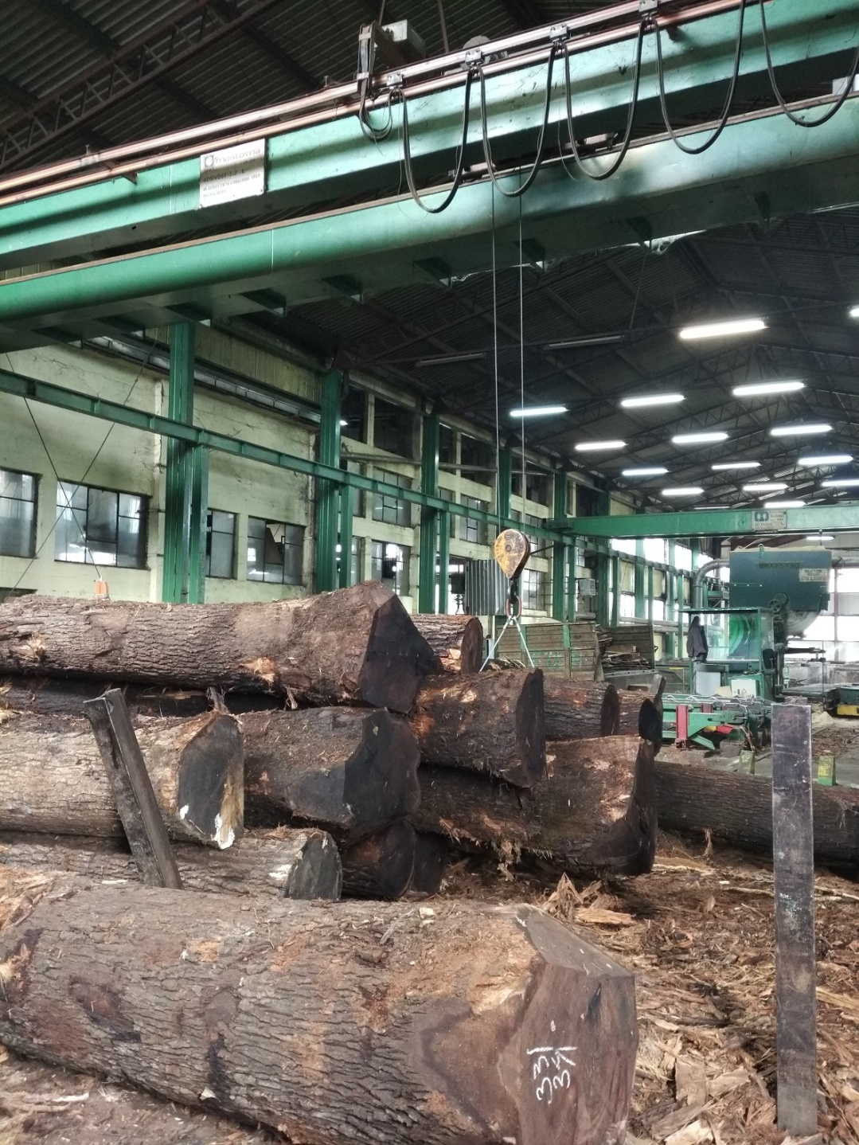
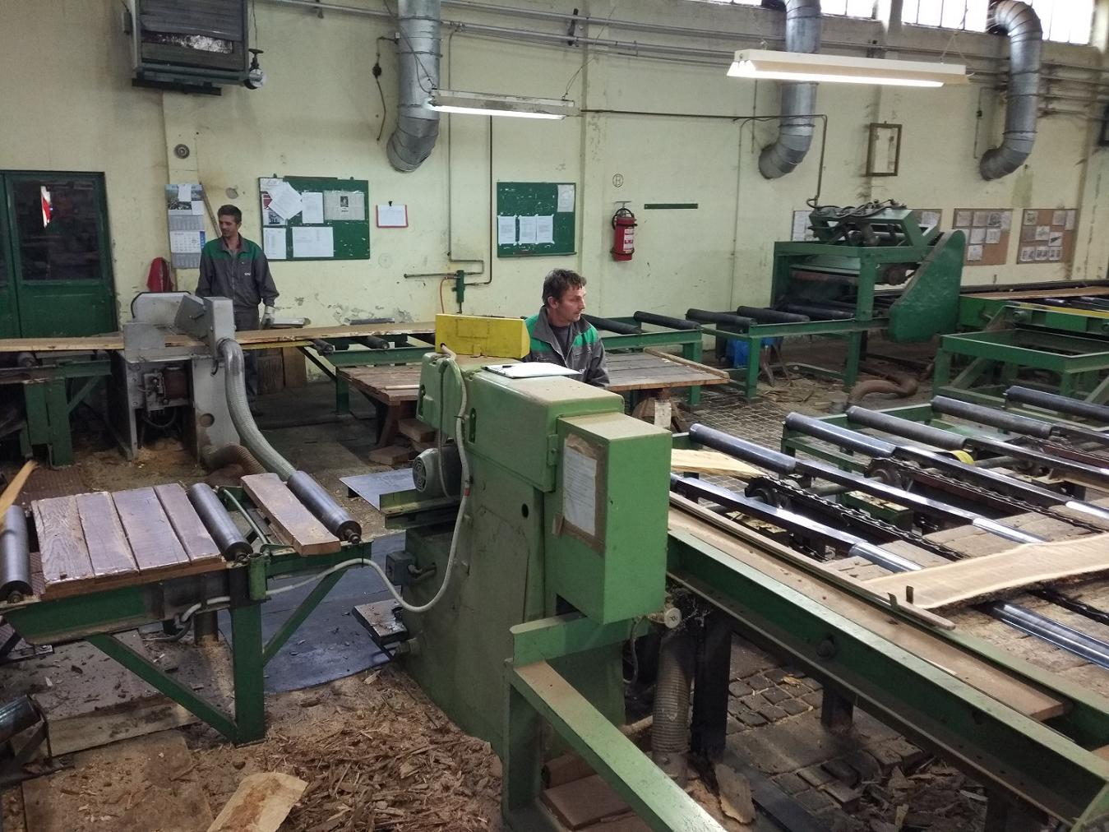

Slide 8
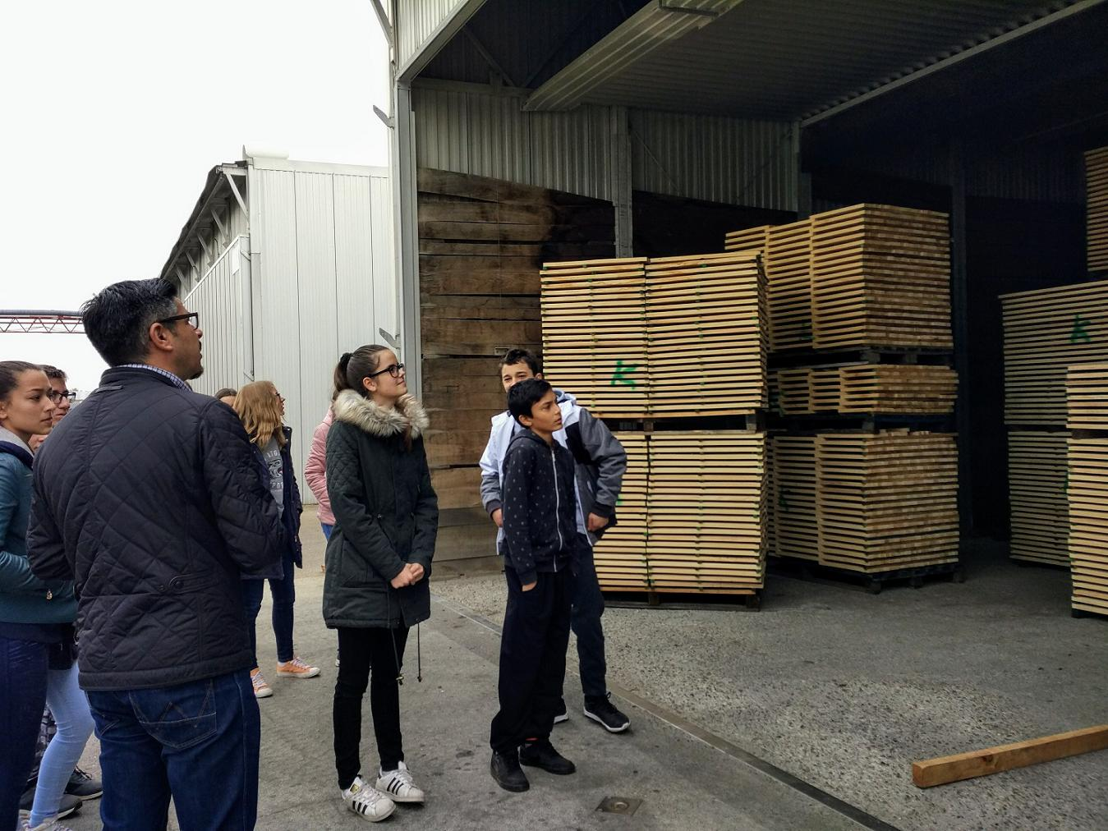
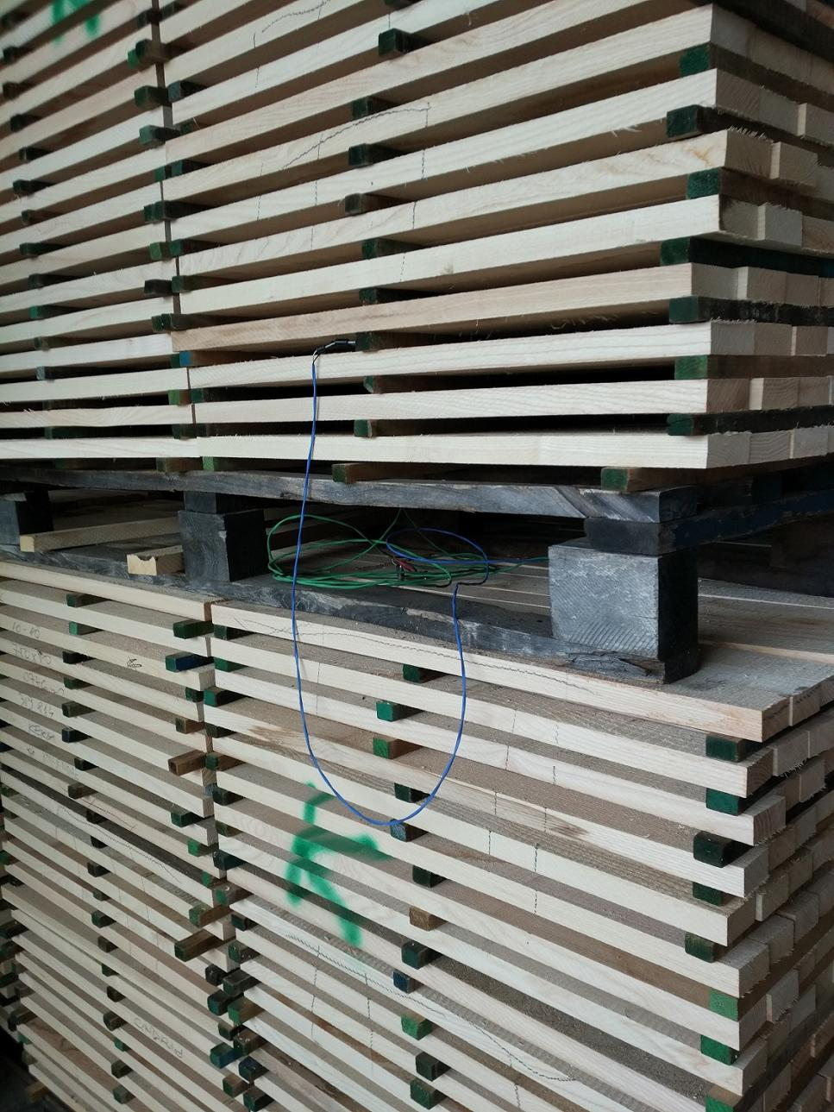
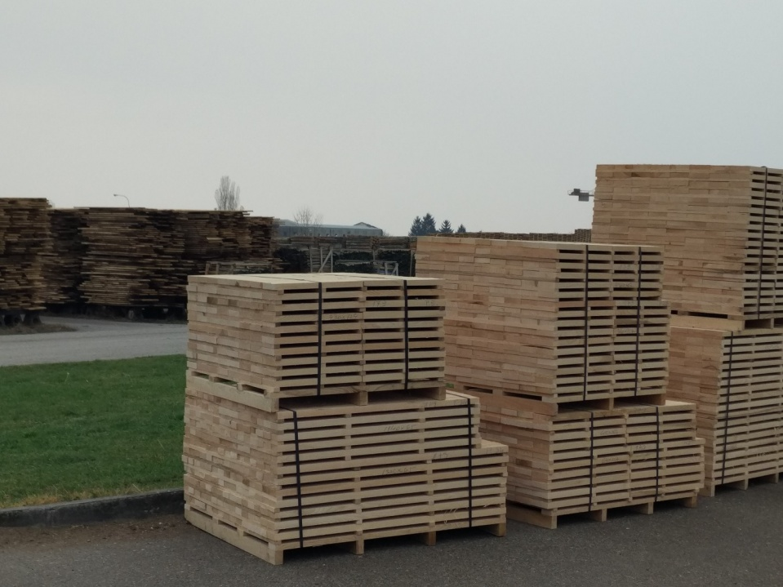
Wood must be dried first.

Slide 9
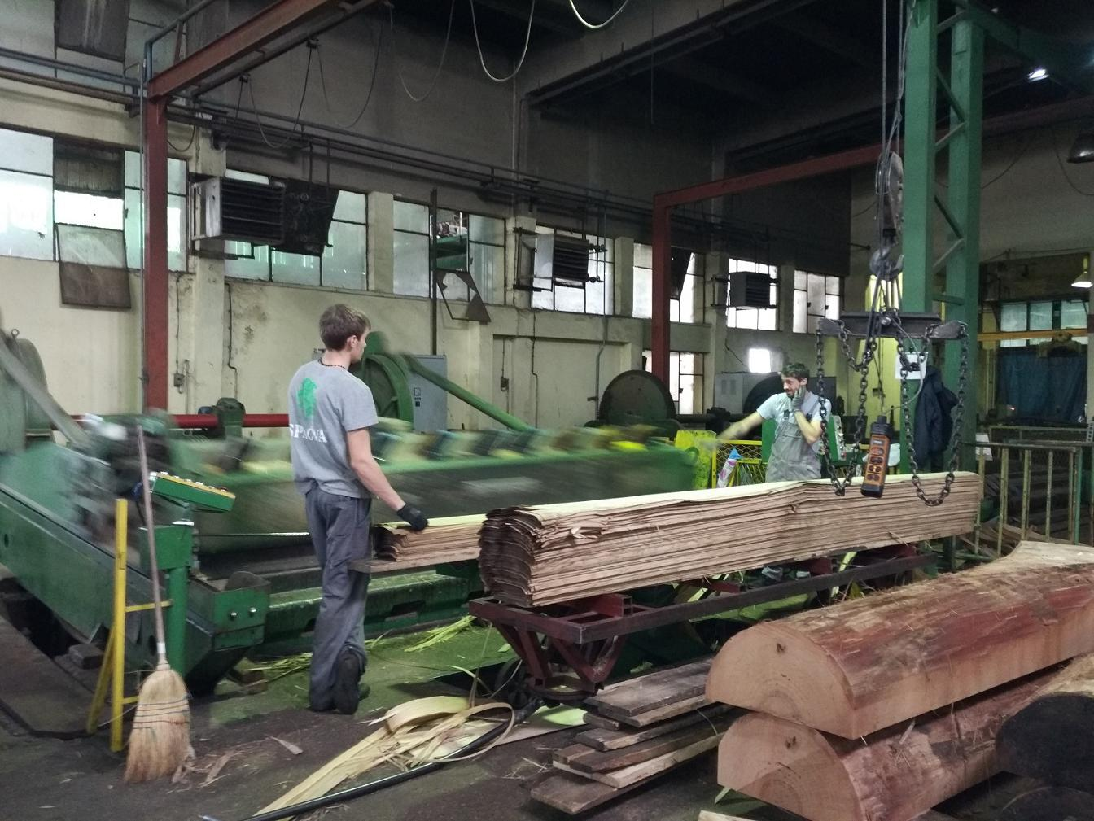
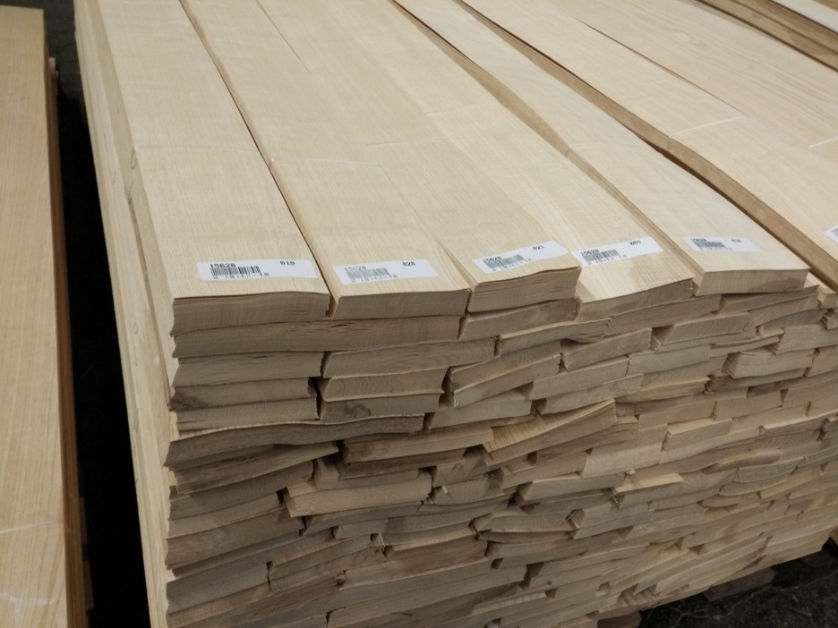
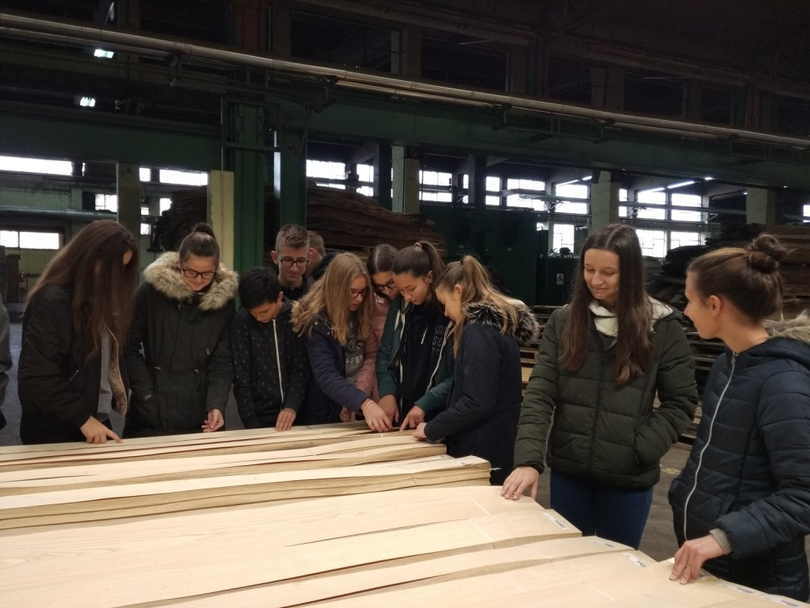
Veneer
-only 0,57 mm thick

Slide 10
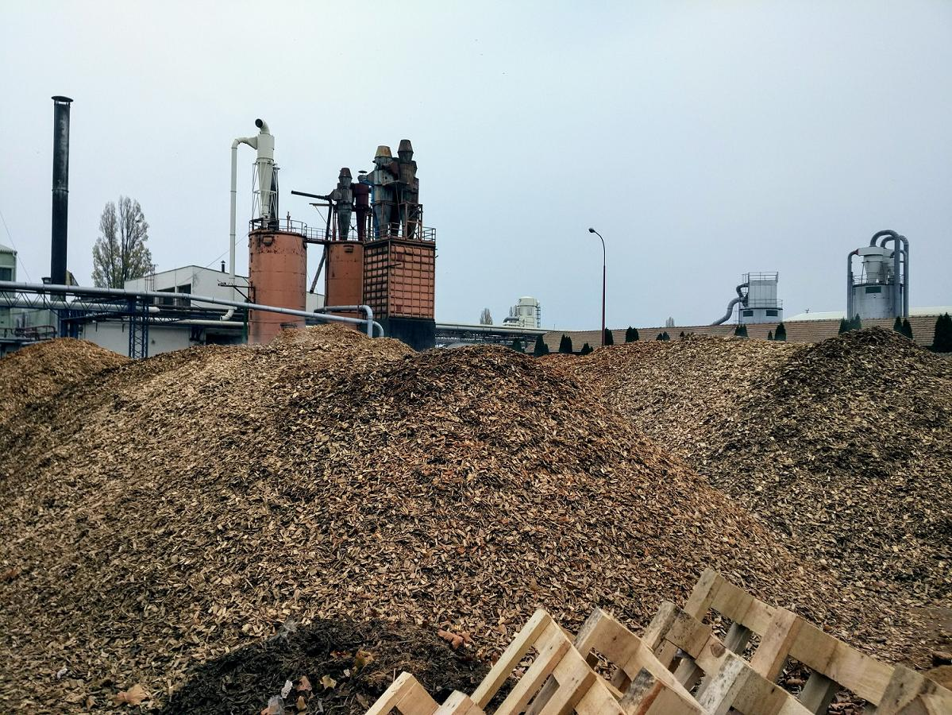
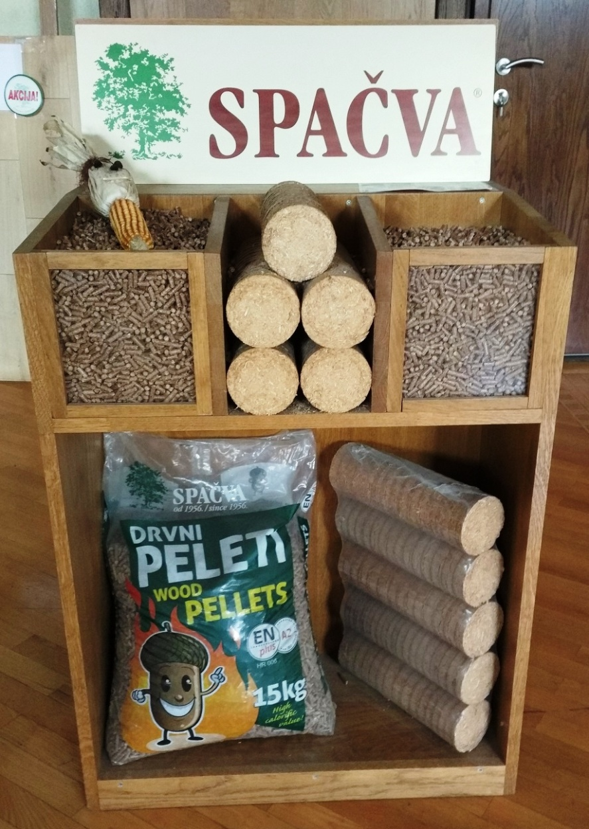
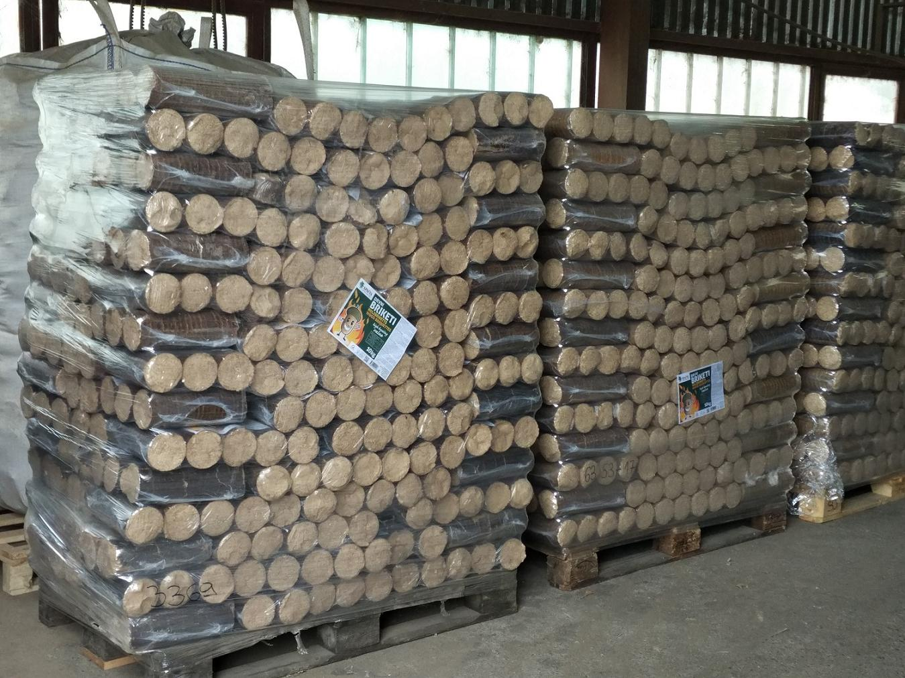
Pellets and briquettes

Slide 11
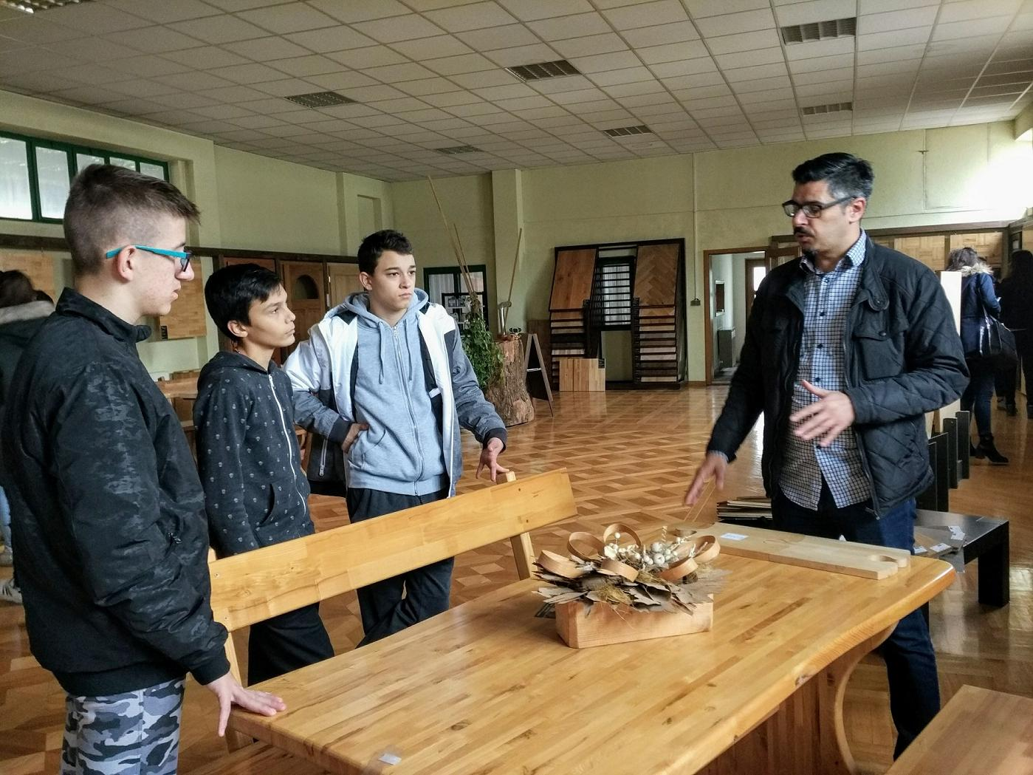
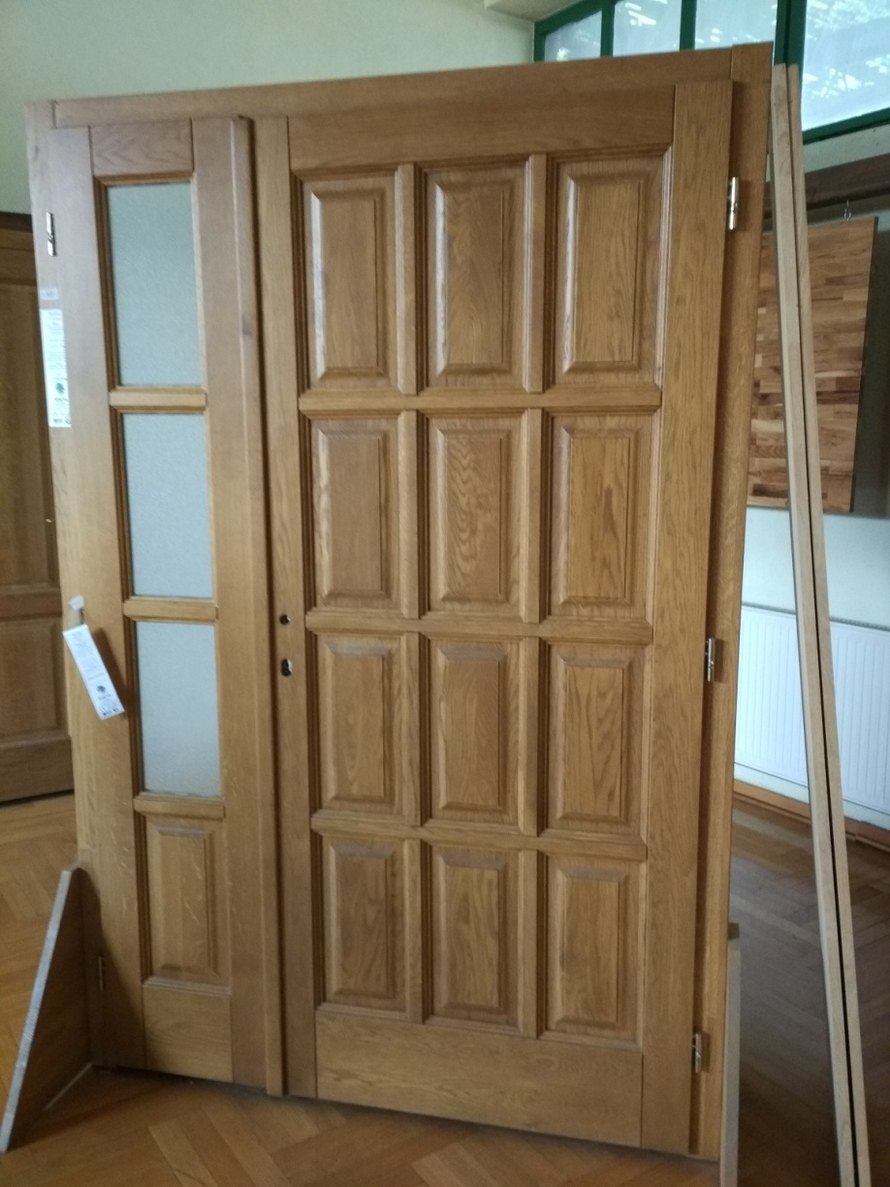
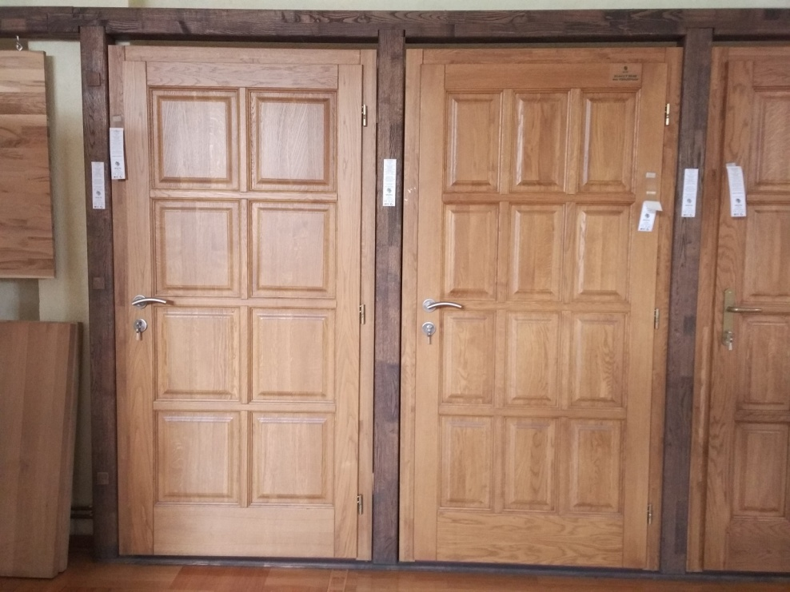
Showroom

Slide 12
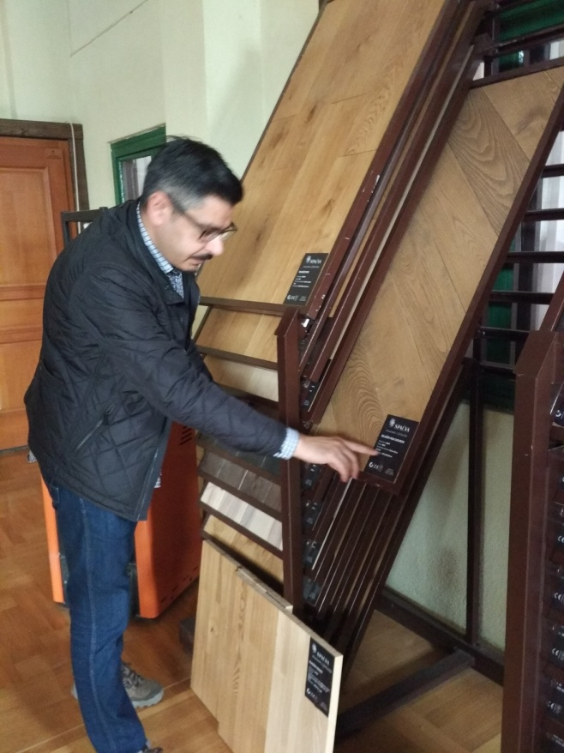
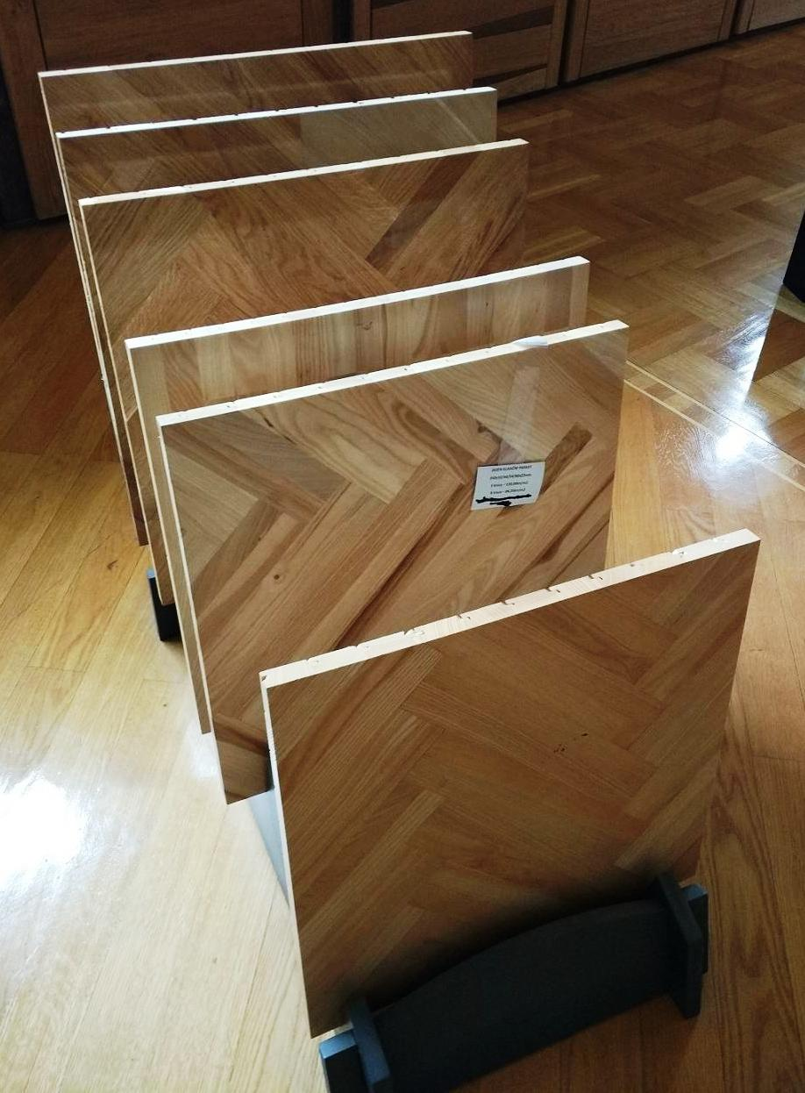
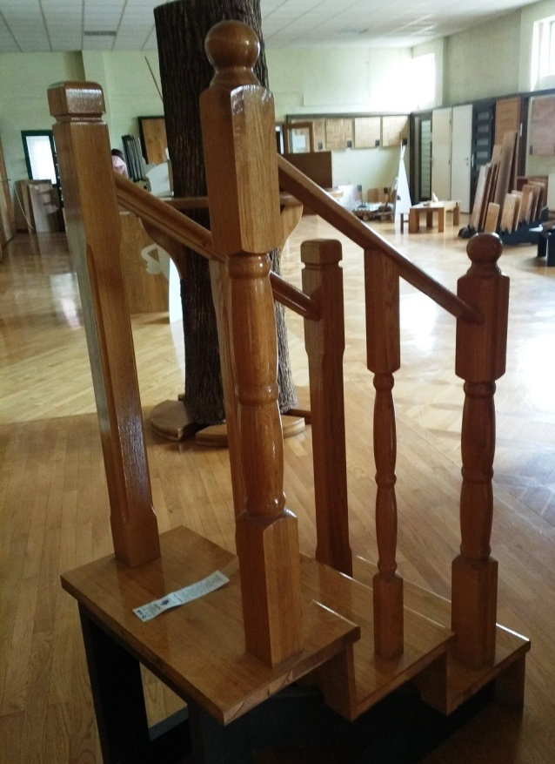
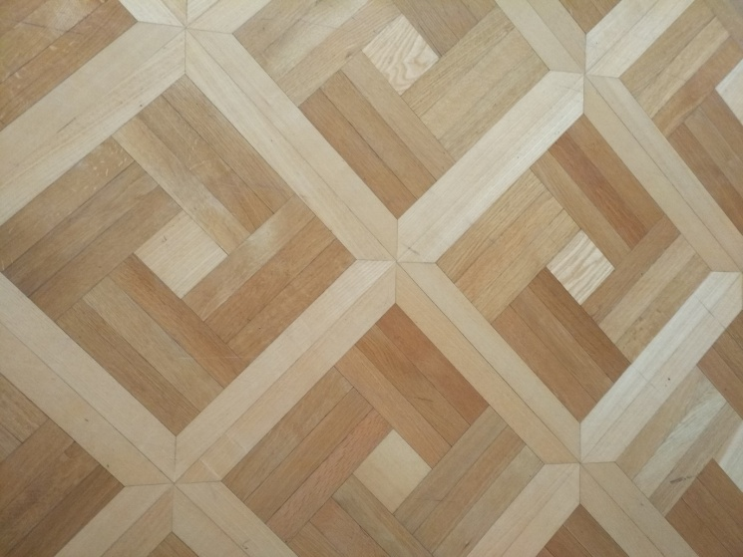
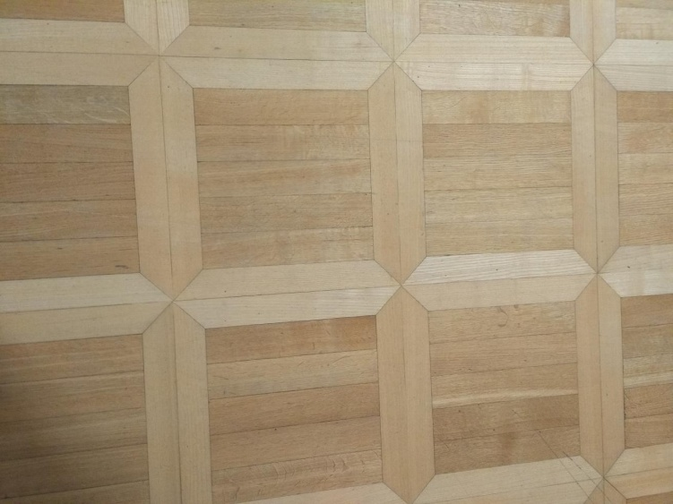

Slide 13
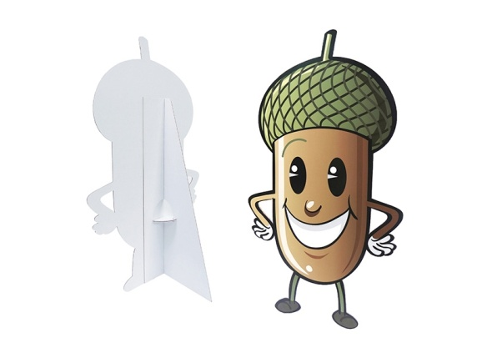
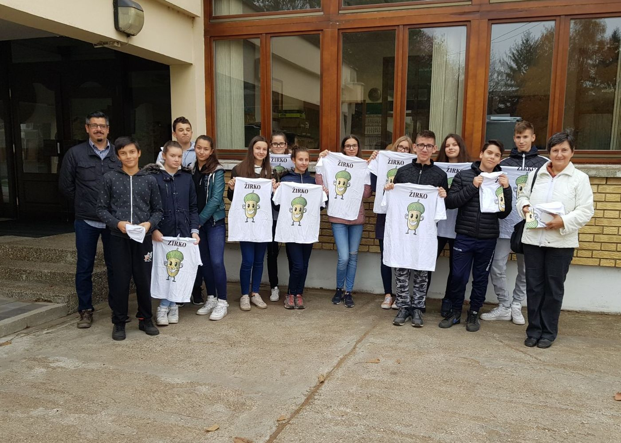
Before leaving “Spačva”, we got presents: T-shirts with mascot ŽIRKO.

